Slide 2
WHAT IS THE AIAS?

Slide 3
The AIAS is an independent, nonprofit, student-run organization dedicated to advancing leadership, design, and service among architecture students

Slide 4
WHAT DOES THE AIAS DO?

Slide 5
The AIAS advances leadership, design, and service among architecture students
AIAS Mission Statement

Slide 6
HOW DOES THE AIAS ADVANCE
LEADERSHIP, DESIGN, AND SERVICE?

Slide 7
A more sustainable, healthy, and equitable future through
the empowerment of student voices, ideas, and actions.
AIAS Vision Statement

Slide 8
WHO IS THE AIAS?

Slide 9
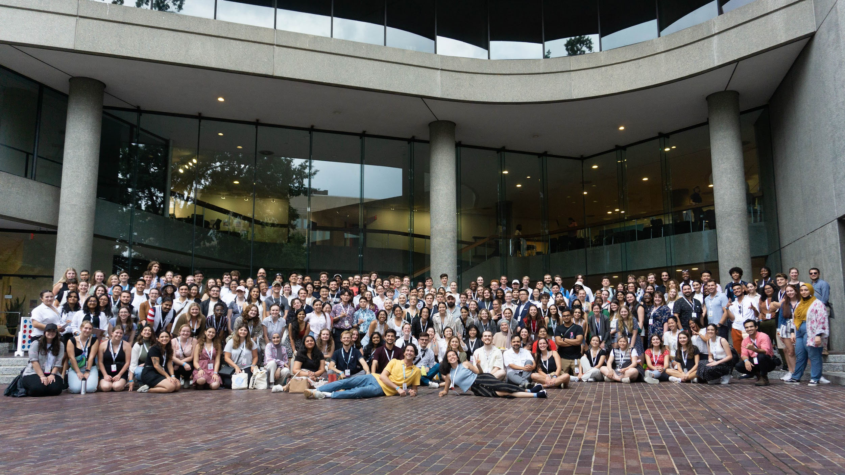
THIS IS THE AIAS
Notes:
Group picture at Grassroots 2022 in Washington DC during the Block Party. The 2022-2023 Board of Directors are in the front with President Cooper Moore in yellow shirt and Vice President Nicole Bass in blue shirt

Slide 10
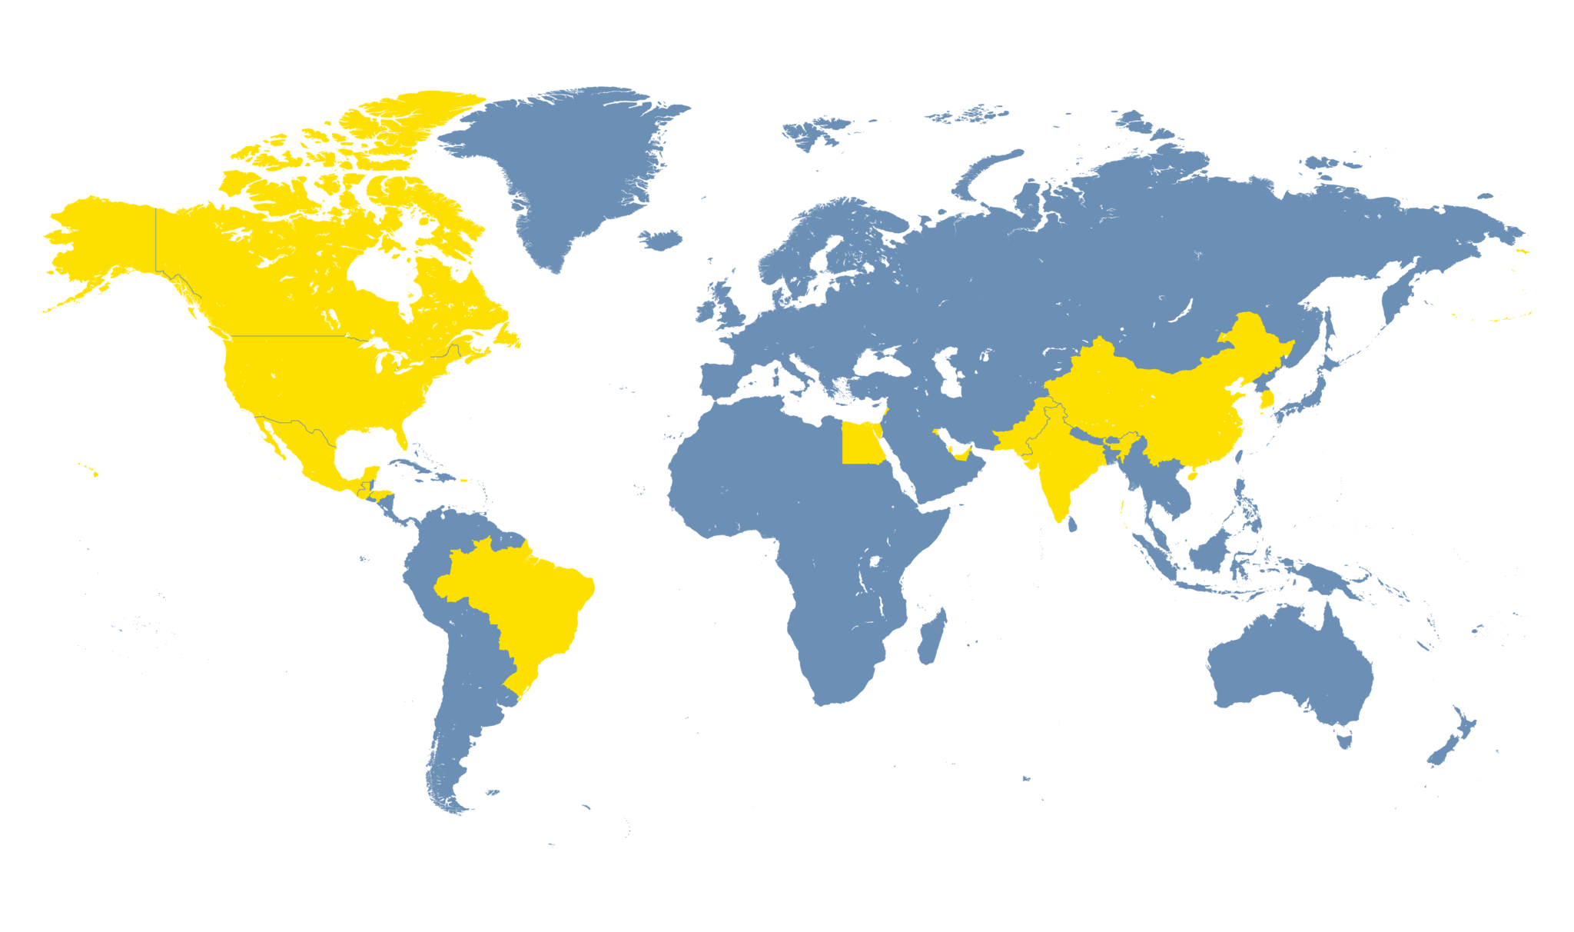
With over 3,000 students

Slide 11
in 300 chapters worldwide!
Notes:
AIAS has 4 quads and 2 regions. With chapters from Hawaii to New York to Brazil to Egypt to China.

Slide 12
That’s 7 time zones!!!

Slide 13
Presentation Review
1
6
National Communications
National Committees, Task Forces, and Leadership Opportunities
2
7
National Programming
National Conferences and Events
3
8
Competitions | Scholarships & Fellowships | Career Center
Council of Presidents
4
9
AIAS Merchandise
Connect with the Alliance
5
10
Recognizing Hard Work and Accomplishments
Quad/Regional Level

Slide 14
WHO ARE THE NATIONAL OFFICERS?

Slide 15
National President
Cooper Moore, AIAS, NOMA, Assoc. AIA
Kent State University
president@aias.org
Calendly
@aiasorg
AIAS

Slide 16
National Vice President
Nicole Bass, AIAS, NOMA, Assoc. AIA
City College of New York
vicepresident@aias.org
Calendly
@aiasorg
AIAS

Slide 17
What do Officers Do?
National President
Chair of AIAS Board of Directors and Council of Presidents
National Committees and Task Forces
Freedom By Design
National Vice President
New Chapters & Reinstating Chapters
Chair of Membership Comm and Fin Comm
General Chapter maintenance
Accessing the Officers!
Chapter Visits
Chapter Advice and Support
Connecting in Quad and National Conferences

Slide 18
WHO ARE THE BOARD OF DIRECTORS?

Slide 19
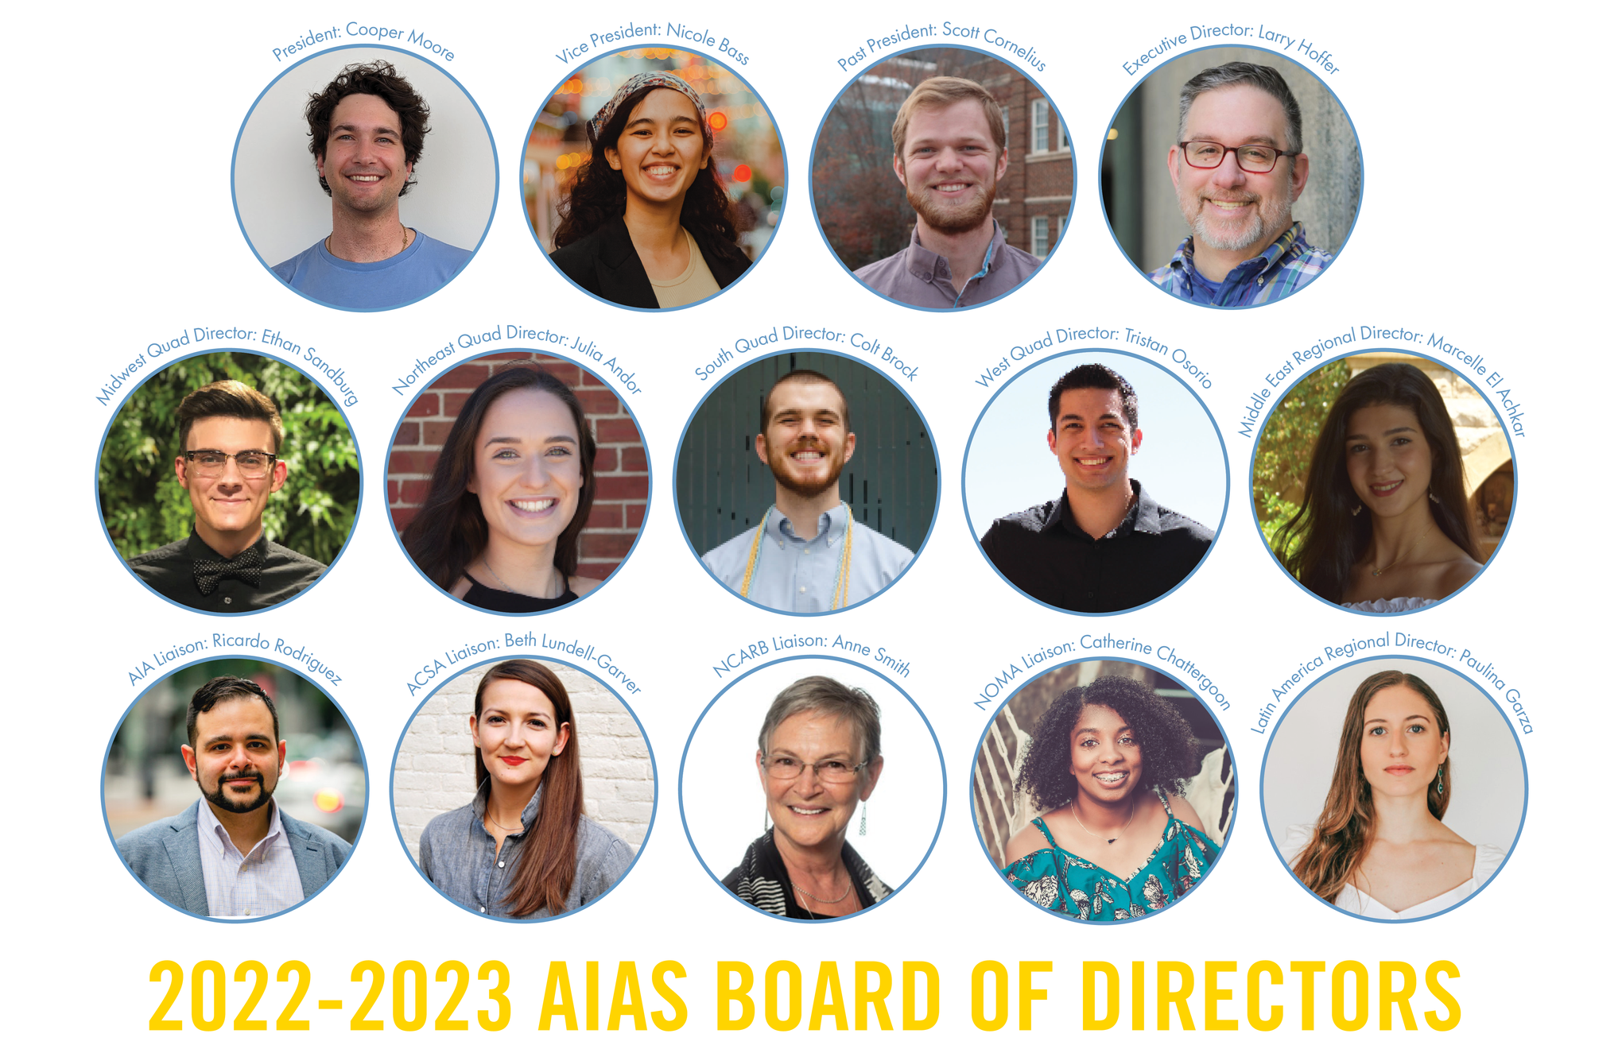
Board of Directors
The AIAS Board of Directors is
comprised of students or recent
graduates elected annually by
members to serve the organization's highest office. With them are appointed liaisons from collateral organizations and the AIAS Executive Director

Slide 20
ON A NATIONAL LEVEL

Slide 21
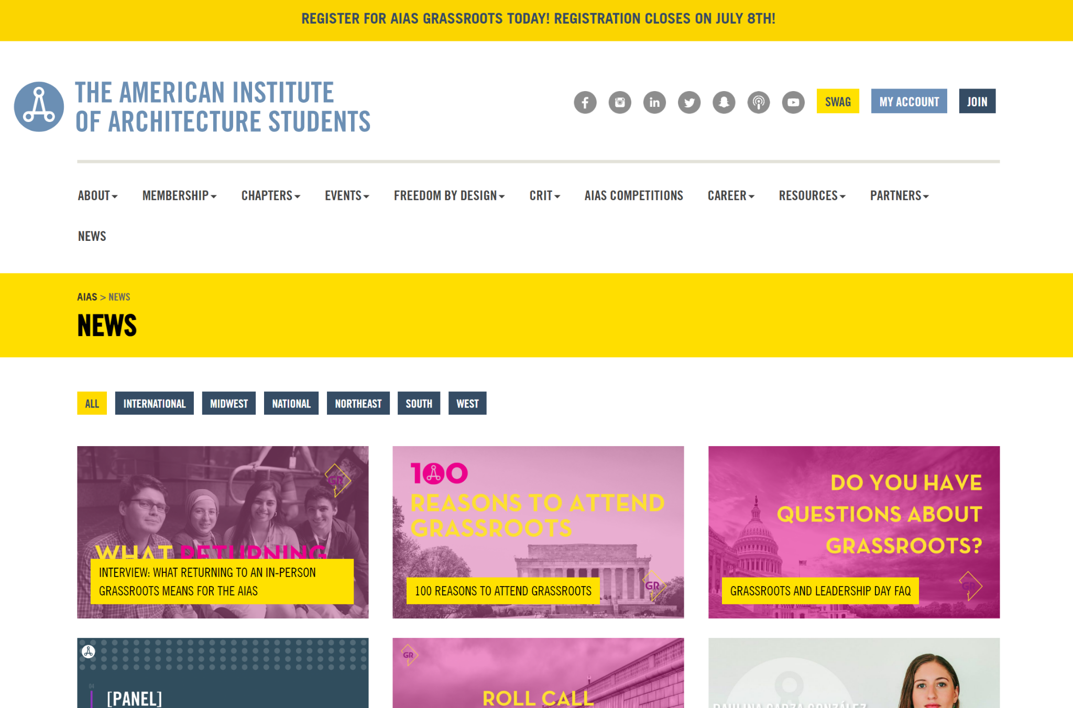
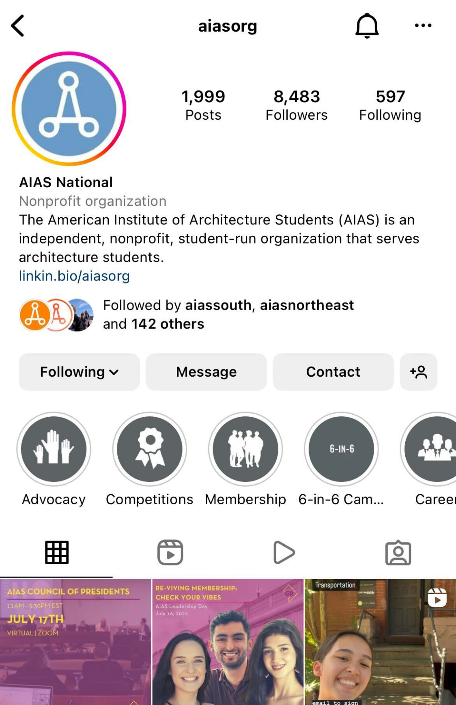
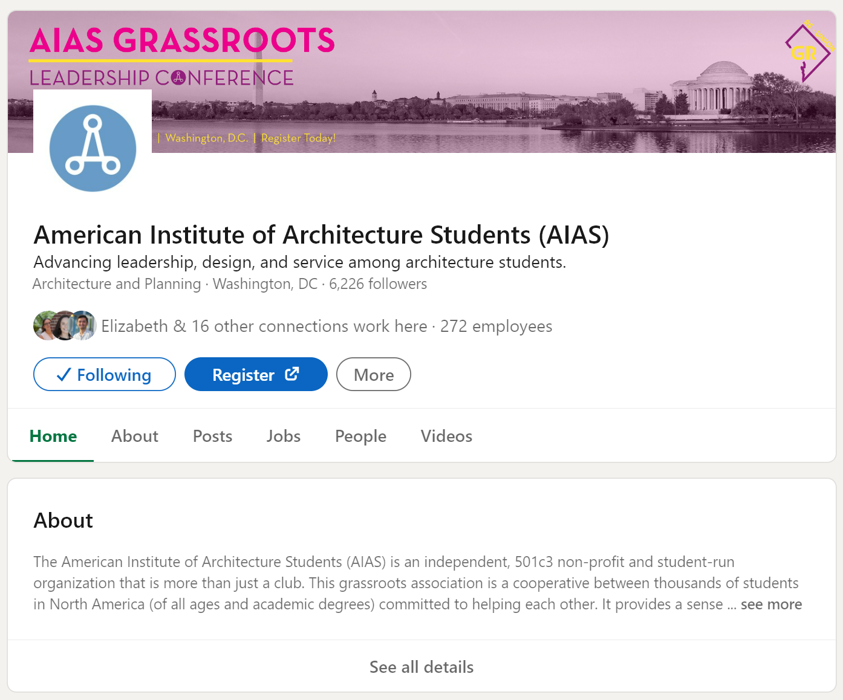
National Communications
@aiasorg
American Institute of Architecture Students (AIAS)
NEWS on aias.org
Emails & Newsletters: You receive as a registered member!
Official AIAS Chapter Gmail: Check in with the National Vice President if you need access

Slide 22
National Programming
CRIT Journal is the premier publication of students in architecture, design, and associated fields.
CRIT Scholar is a research-based fellowship program that supports student research.
CAMP - Chapter Alumni Mentorship Program is an opportunity to give our alumni who have given their time and resources to the organization, an opportunity to engage with AIAS chapters as their mentors.
THRIVE WEBINARS are a series of educational sessions and networking events for members.
Freedom By Design is an AIAS community service program partnered with NCARB to have design-build projects
Notes:
Crit Journal is the premier publication of student’s in architecture, design, and associated fields. Published since 1976, CRIT offers a variety of opportunities for AIAS members and acts as a forum for critical discourse and the dissemination of knowledge.
Crit Scholar is a research-based fellowship program that aims to support student research and serves as an exclusive opportunity for students to receive further guidance in their own research.
CAMP - Chapter Alumni Mentorship Program is opportunity to give our alumni who have given their time and resources to the organization, an opportunity to engage with AIAS chapters as their mentors.
THRIVE WEBINAR is a series of educational sessions and networking events for members that will cover tips and tricks for thriving in the profession.
Freedom By Design is an AIAS community service program partnered with NCARB to have design-build projects and engage in solutions to address 5 barriers:
Physical
Educational
Environmental
Socio-Economic
Cultural

Slide 23
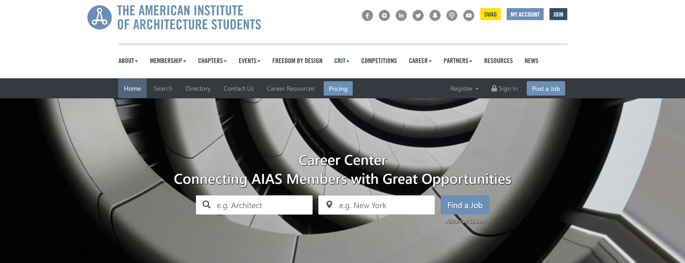
Competitions | Scholarships & Fellowships | Career Center
Competitions
AIAS hosts and sponsors design competitions for members to apply their design skills.
Scholarships & Fellowships
The National Office updates and maintains the page for students to get the most up-to-date information.
If you know any scholarships/fellowships, you can submit them to the list!
Career Center
The National Office updates and maintains the page for students to get the latest job opportunities

Slide 24
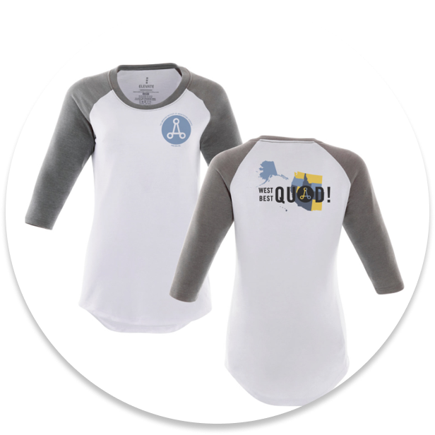
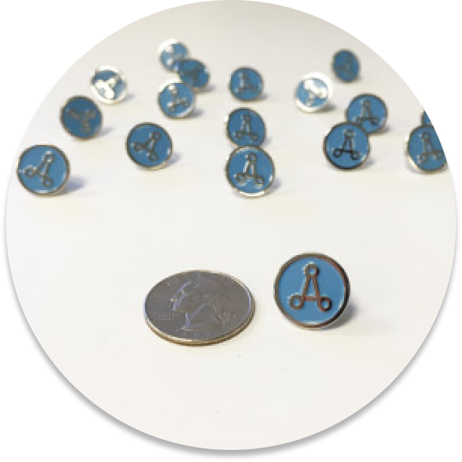
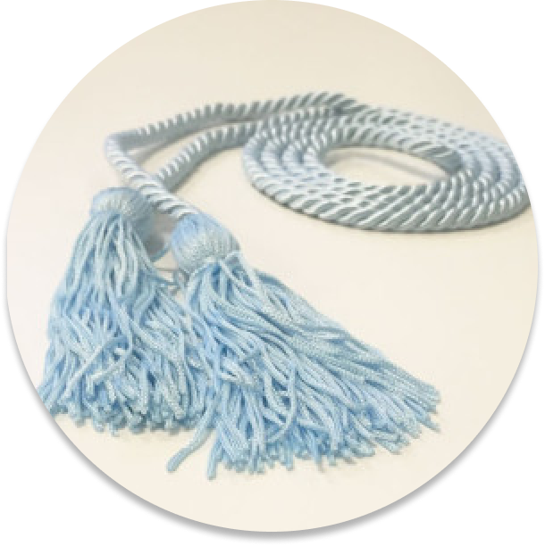
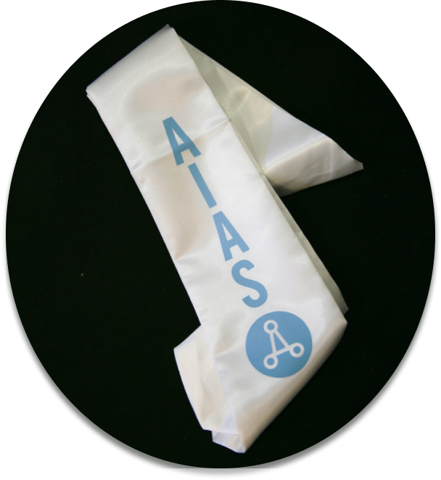
AIAS Merchandise
National
Canvas Bags
Stickers
Pins
Shirts
Quad/Regional
Quad Shirts
Quad Stickers
Graduation
Graduation Cords
Graduation Stoles
Log into your AIAS account to check out more merchandise!

Slide 25
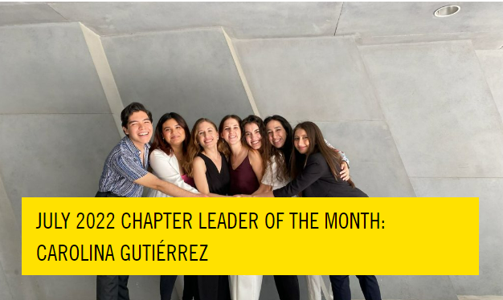
Recognizing Hard Work and Accomplishments
Chapter Leader of the Month highlights the outstanding dedication and accomplishments of one of its members every month.
AIAS Honor Awards publicly recognize individuals and groups for their exemplary work in areas such as leadership, collaboration, scholarship, and service.
Celebrating the Graduating Class honors the hardworking and deserving members graduating this year.

Slide 26
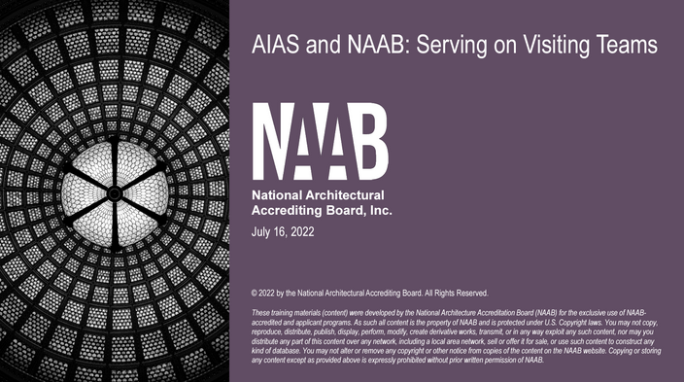
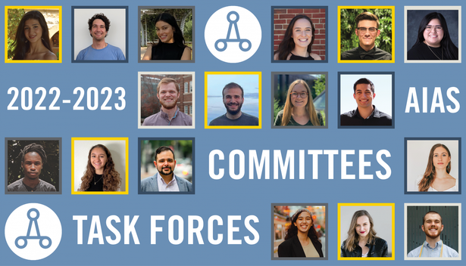
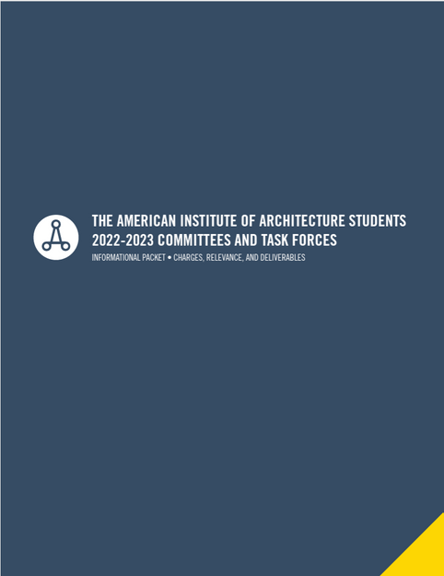
National Committees, Task Forces, and Leadership Opportunities
Committees and Task Forces is a method the AIAS works each year to address issues affecting students around the world.
NCARB Student Licensing Advisor is a role to be trained and updated about AXP Hours, the connection between admin/faculty and the student, and go to sessions about Health Safety and Welfare (HSW)
AIAS Activists program is an action-focused program as they work to research and present their chosen topics.
AIAS Board of Directors are students or recent graduates elected annually by members to serve the AIAS' highest office to run the organization.
NAAB Accreditation Team Student Representative serves as a member of a team evaluating architecture programs for accreditation decisions.
Notes:
Committees and Task Forces is a method the AIAS works each year to address issues affecting students around the world. Examples are:
Governance Committee
Freedom By Design Committee
Justice, Equity, Diversity & Inclusion Task Force
Student Health & Wellbeing Task Force
NCARB Student Licensing Advisor is a role to be trained and updated about AXP Hours, the connection between admin/faculty and the student, and go to sessions about Health Safety and Welfare (HSW)
AIAS Advocate program is an evolution of the Advocates program. This year our Activists will be more action-focused as they work to research and present their chosen topics.
AIAS Board of Directors are students or recent graduates elected annually by members to serve the AIAS' highest office to run the organization in their respective roles
NAAB Accreditation Team Student Representative serves as a member of a team evaluating architecture programs for accreditation decisions.

Slide 27
National Conferences and Events
Grassroots is our summer conference with a weekend's worth of chapter and personal leadership training, community building, and innovative content.
FORUM is our winter conference where we learn from other leaders, discuss issues relevant to architecture and design education, and conduct official AIAS business.
Leadership Day is the day that we spend time learning about all things AIAS, including how to run a chapter, how to become involved nationally in the AIAS, the AIAS’ roles within your school, and more!
Notes:
Grassroots is our summer conference with a weekend's worth of chapter and personal leadership training, community building, and innovative content.
FORUM is our winter conference where we learn from other leaders, discuss issues relevant to architecture and design education, and conduct official AIAS business.
Leadership Day is the day that we spend time learning about all things AIAS, including how to run a chapter, how to become involved nationally in the AIAS, the AIAS’s roles within your school, and more!
Roll Call is a chance for chapters to show off their creativity with a chant, a skit, a video, or anything in between.
National Career Expo is a network event with top firms, organizations, and universities, and learn from the professionals that are in or associated with the field.

Slide 28
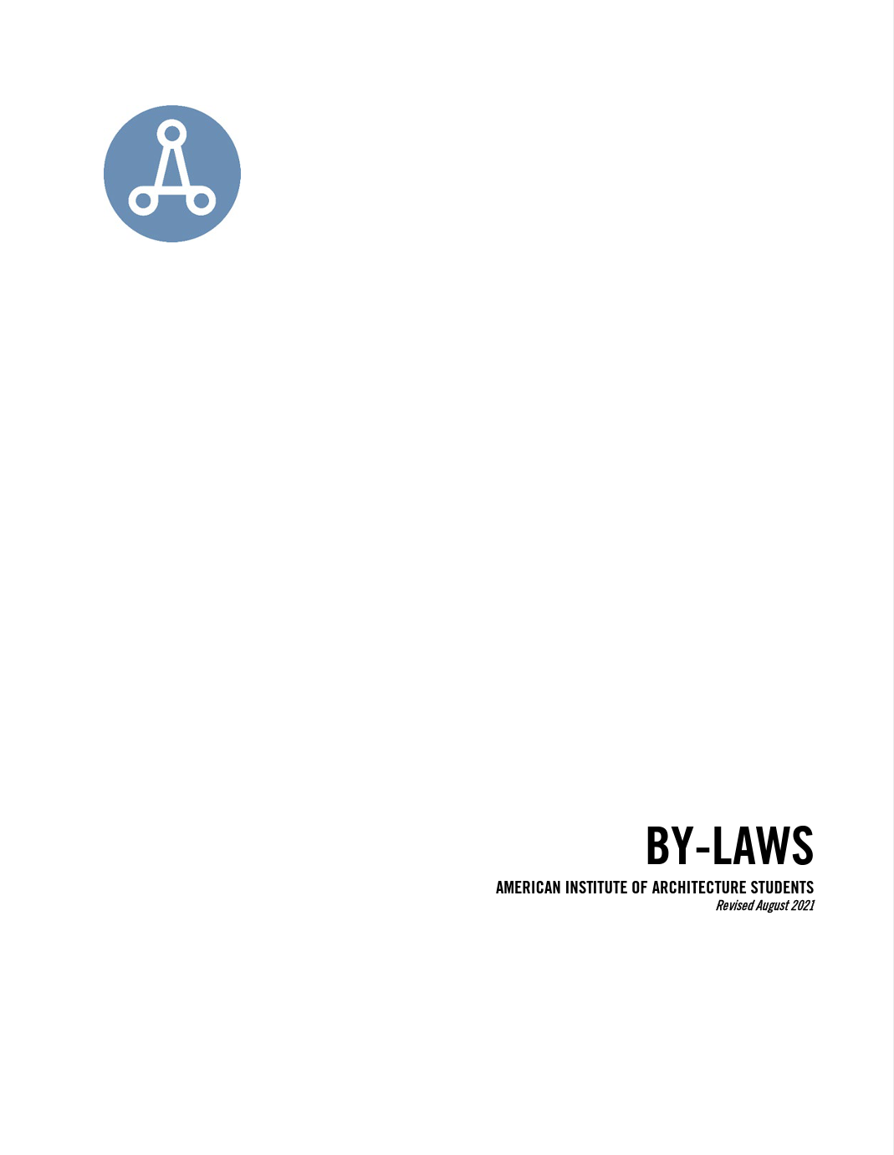
Council of Presidents
Being a representative for your chapter as Chapter President to:
Vote on important motions, amendments about the organization. During the Winter CoP, chapters will vote in National Elections for the next AIAS Officers and Directors.
If there is a scheduling conflict, you can appoint a Delegate from your chapter. If not, you can request another Chapter President/Delegate to be your Proxy.
Chat with the National Vice President about confirming yourself as your chapter representative.
Chat with the National President to talk about CoP Agendas, motions, and amendments.

Slide 29
Connect with the Alliance
ACSA - Association of Collegiate Schools of Architecture
National Vice President is the Student Director for the ACSA Board of Directors
ACSA Liaison sits on AIAS BoD
AIA - American Institute of Architects
National President sits on the AIA Strategic Council and then on the Board of Directors
AIA Liaison sits on AIAS BoD
NAAB - National Architectural Accrediting Board
AIAS Member sits on NAAB BoD
NCARB - National Council of Architectural Registration Boards
NCARB Liaison sits on AIAS BoD
NOMA/S - National Organization of Minority Architects
NOMA Liaison sits on AIAS BoD
Notes:
The alliance is the non-profit architectural organization that works together in the architecture education and field.
ACSA - Association of Collegiate Schools of Architecture is an international association of architecture schools preparing future architects, designers, and change agents.
National Vice President is the Student Director for the ACSA Board of Directors
AIA - American Institute of Architects works to advance our nation’s quality of life and protect the public’s health, safety, and welfare
National President sits on the AIA Strategic Council and then on the Board of Directors
NAAB - National Architectural Accrediting Board develops and maintains an accreditation system in professional degree education that enhances the value, relevance, and effectiveness of the profession of architecture.
NCARB - National Council of Architectural Registration Boards facilitates the licensure and credentialing of architects to protect the health, safety, and welfare of the public.
NOMA/S - National Organization of Minority Architects is to empower our local chapters and membership to foster justice and equity in communities of color through outreach, community advocacy, professional development and design excellence.

Slide 30
ON A QUAD/REGIONAL LEVEL

Slide 31
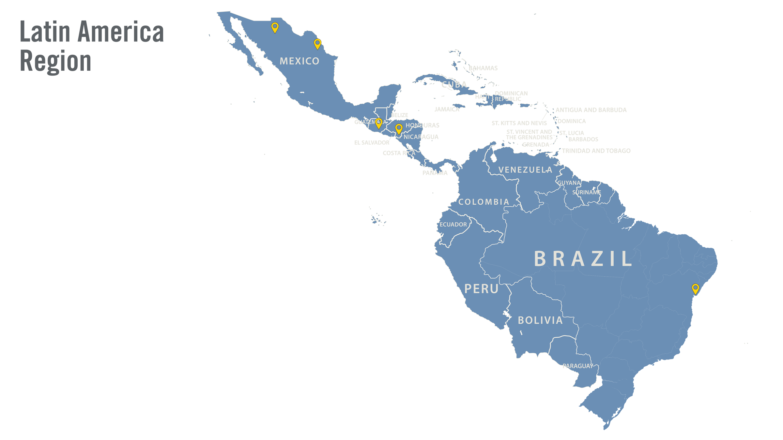
Over 5 chapters
Find your nearest AIAS Chapter here

Slide 32
Latin America Regional Director
Paulina Garza Gonzalez
Universidad de Monterrey
latinamerica@aias.org
@aiaslatinamerica
aiasinternational.slack.com

Slide 33
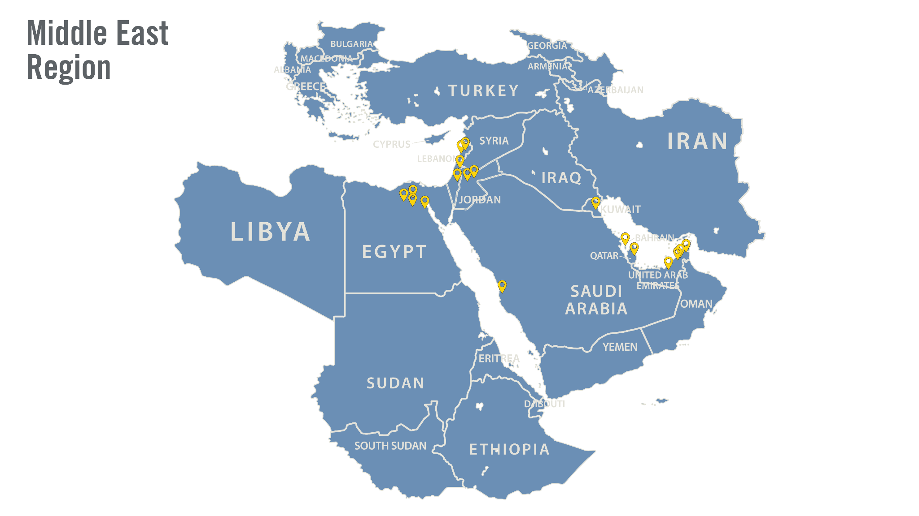
Over 22 chapters
Find your nearest AIAS Chapter here

Slide 34
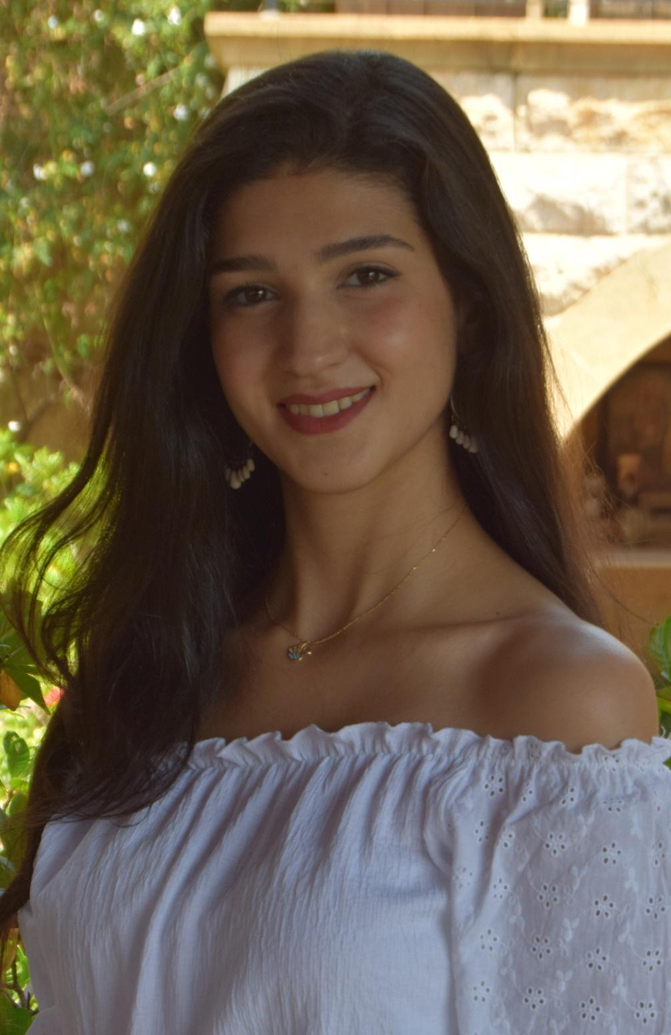
Middle East Regional Director
Marcelle El Achkar
Holy Spirit University of Kaslik (USEK)
middleeast@aias.org
Calendly
@aiasmiddleeast
aiasinternational.slack.com

Slide 35
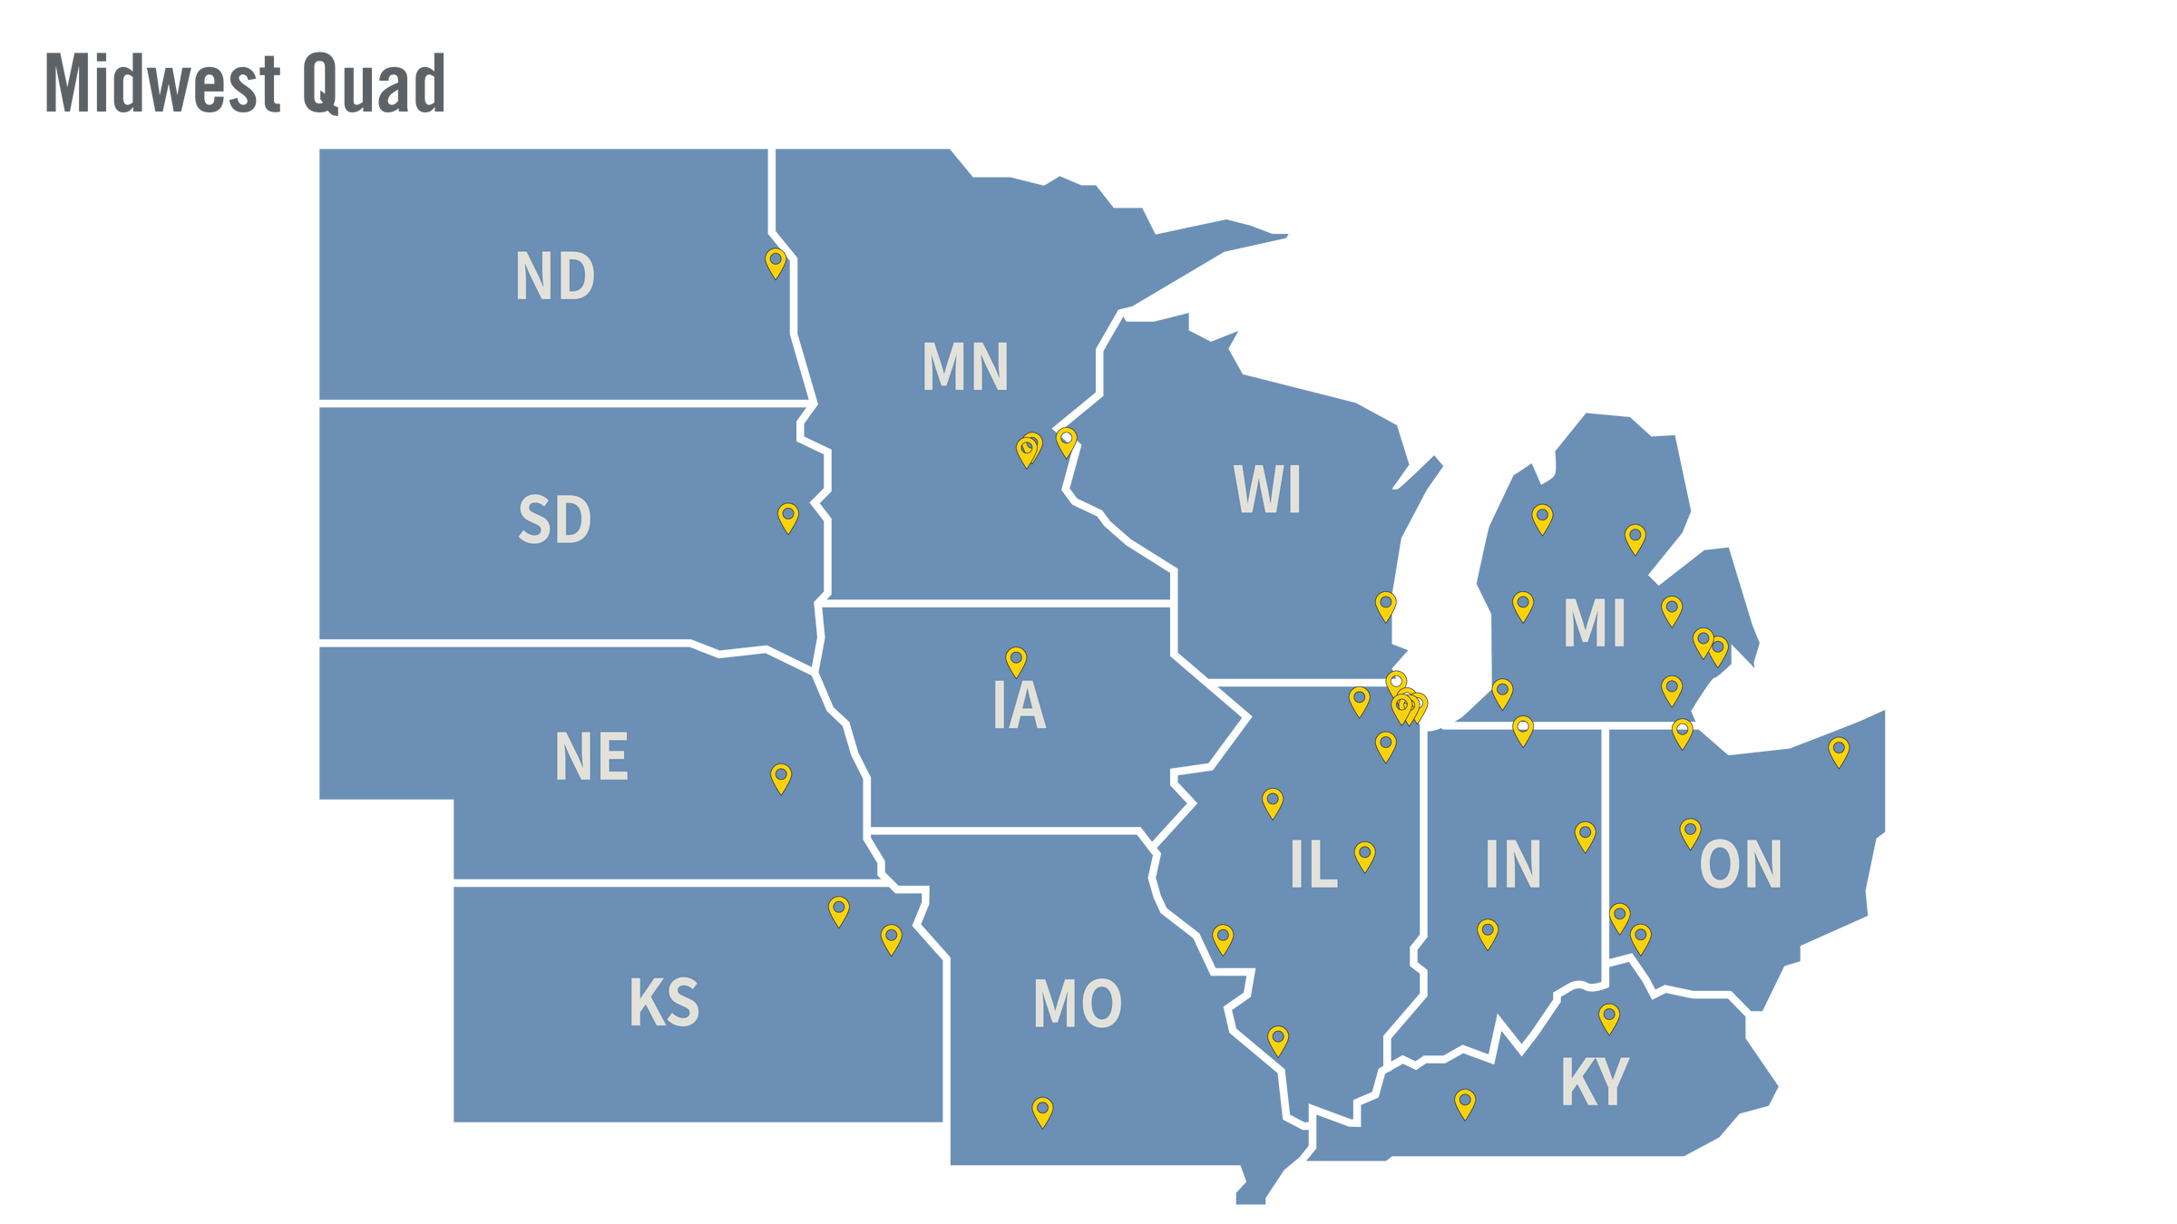
Over 50 chapters
Find your nearest AIAS Chapter here

Slide 36
Midwest Quad Director
Ethan Sandburg
University of Kansas
midwest@aias.org
Calendly
@aiasmidwest
midwestquad.slack.com

Slide 37
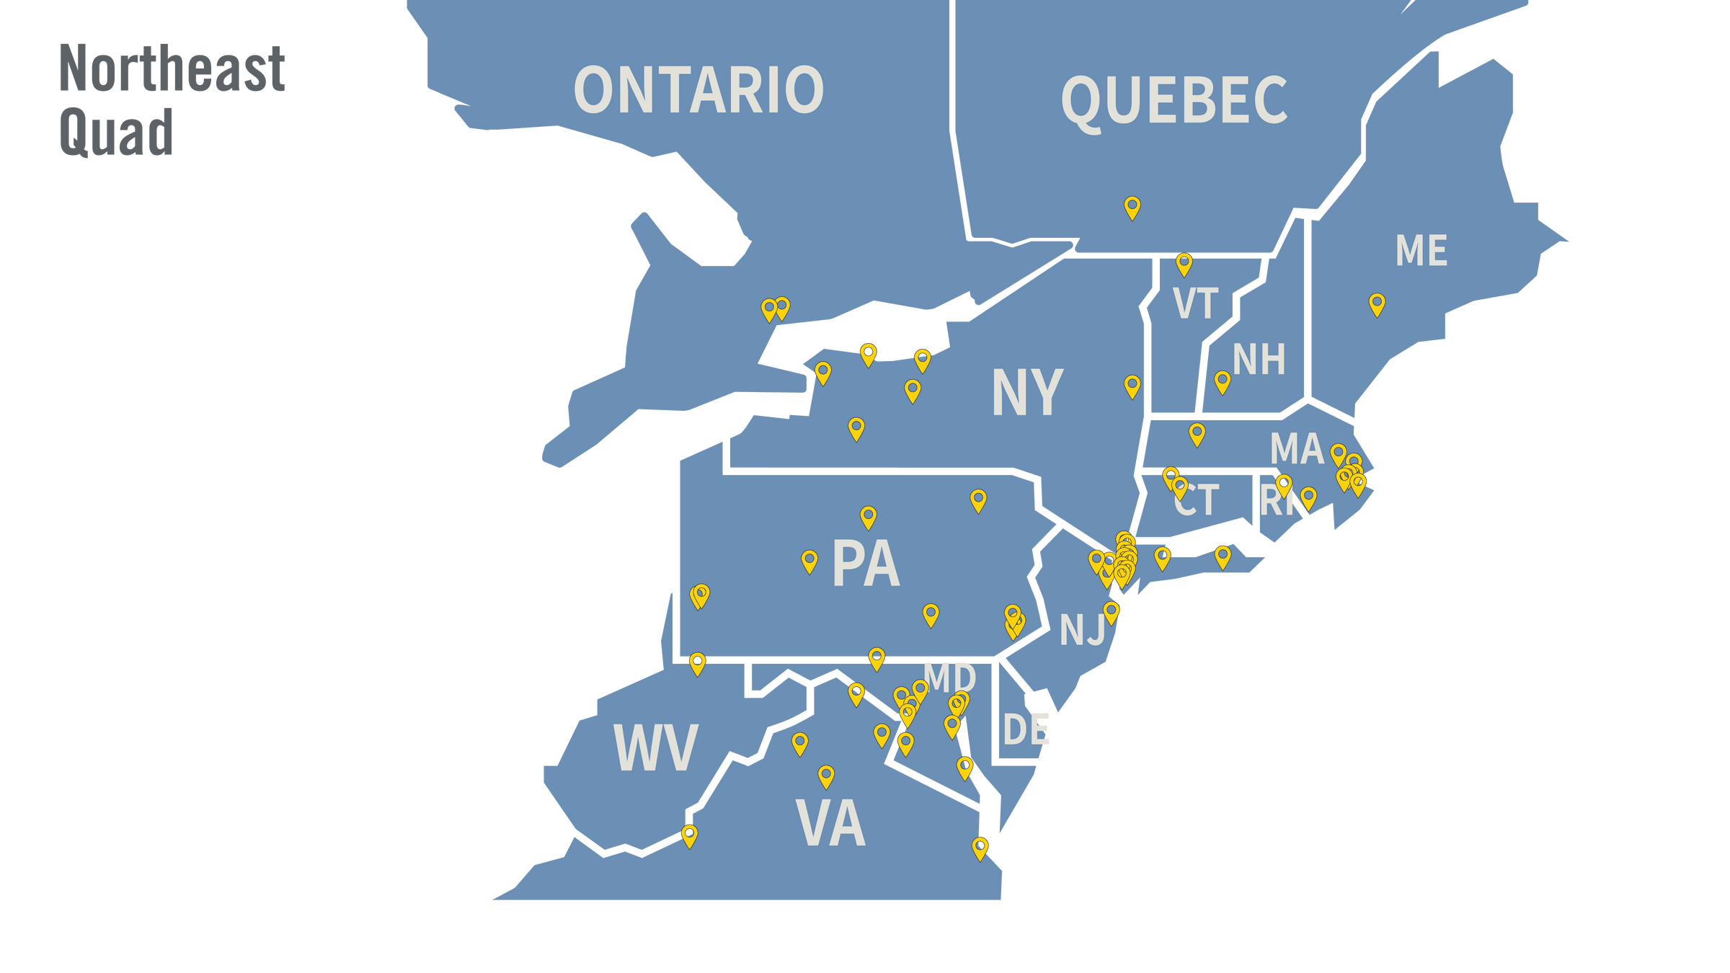
Over 72 chapters Find your nearest AIAS Chapter here

Slide 38
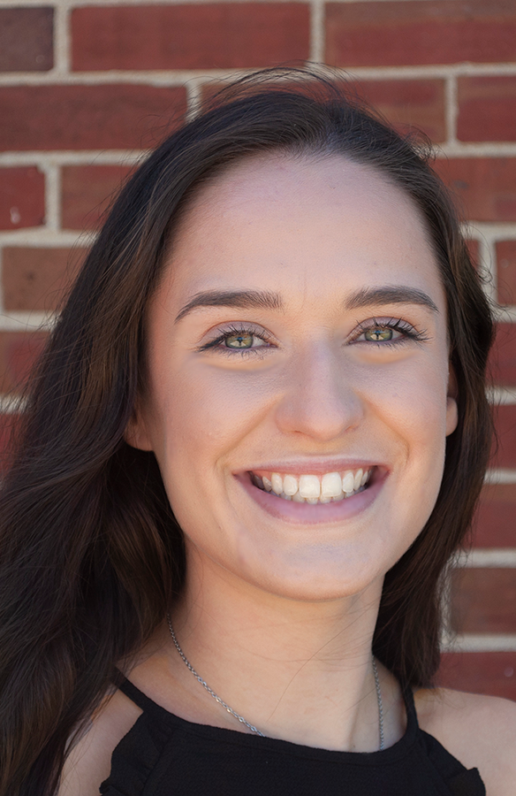
Northeast Quad Director
Julia Andor
New York Institute of Technology – Long Island
northeast@aias.org
Calendly
@aiasnortheast
nequad.slack.com

Slide 39
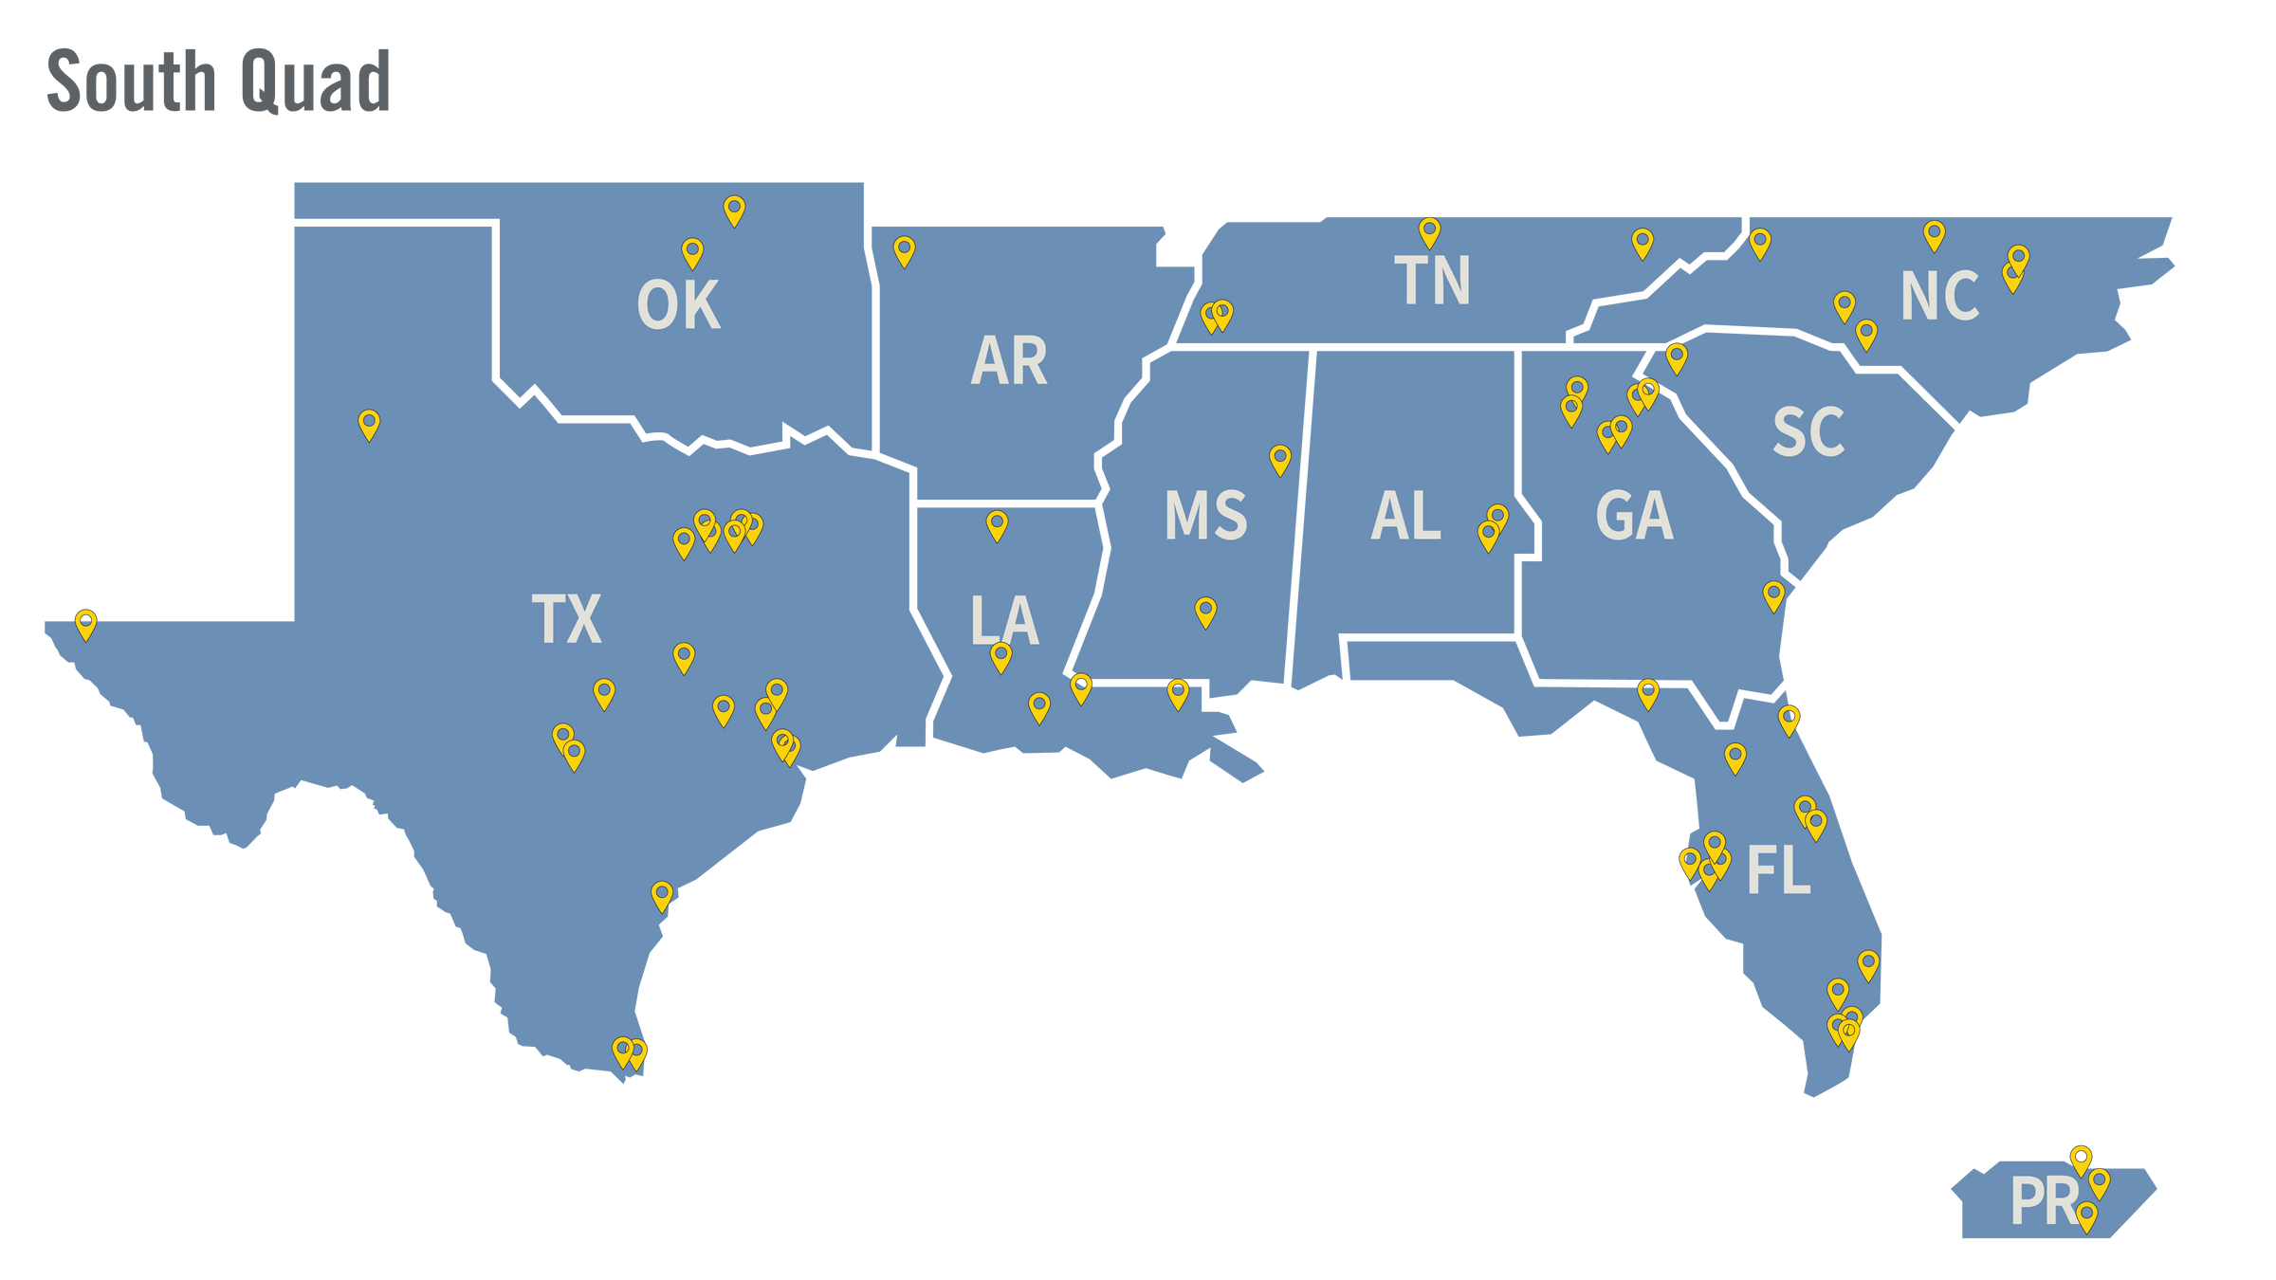
Over 77 chapters
Find your nearest AIAS Chapter here

Slide 40
South Quad Director
Colt Brock
Georgia Institute of Technology
south@aias.org
Calendly
@aiassouth
southquad.slack.com

Slide 41
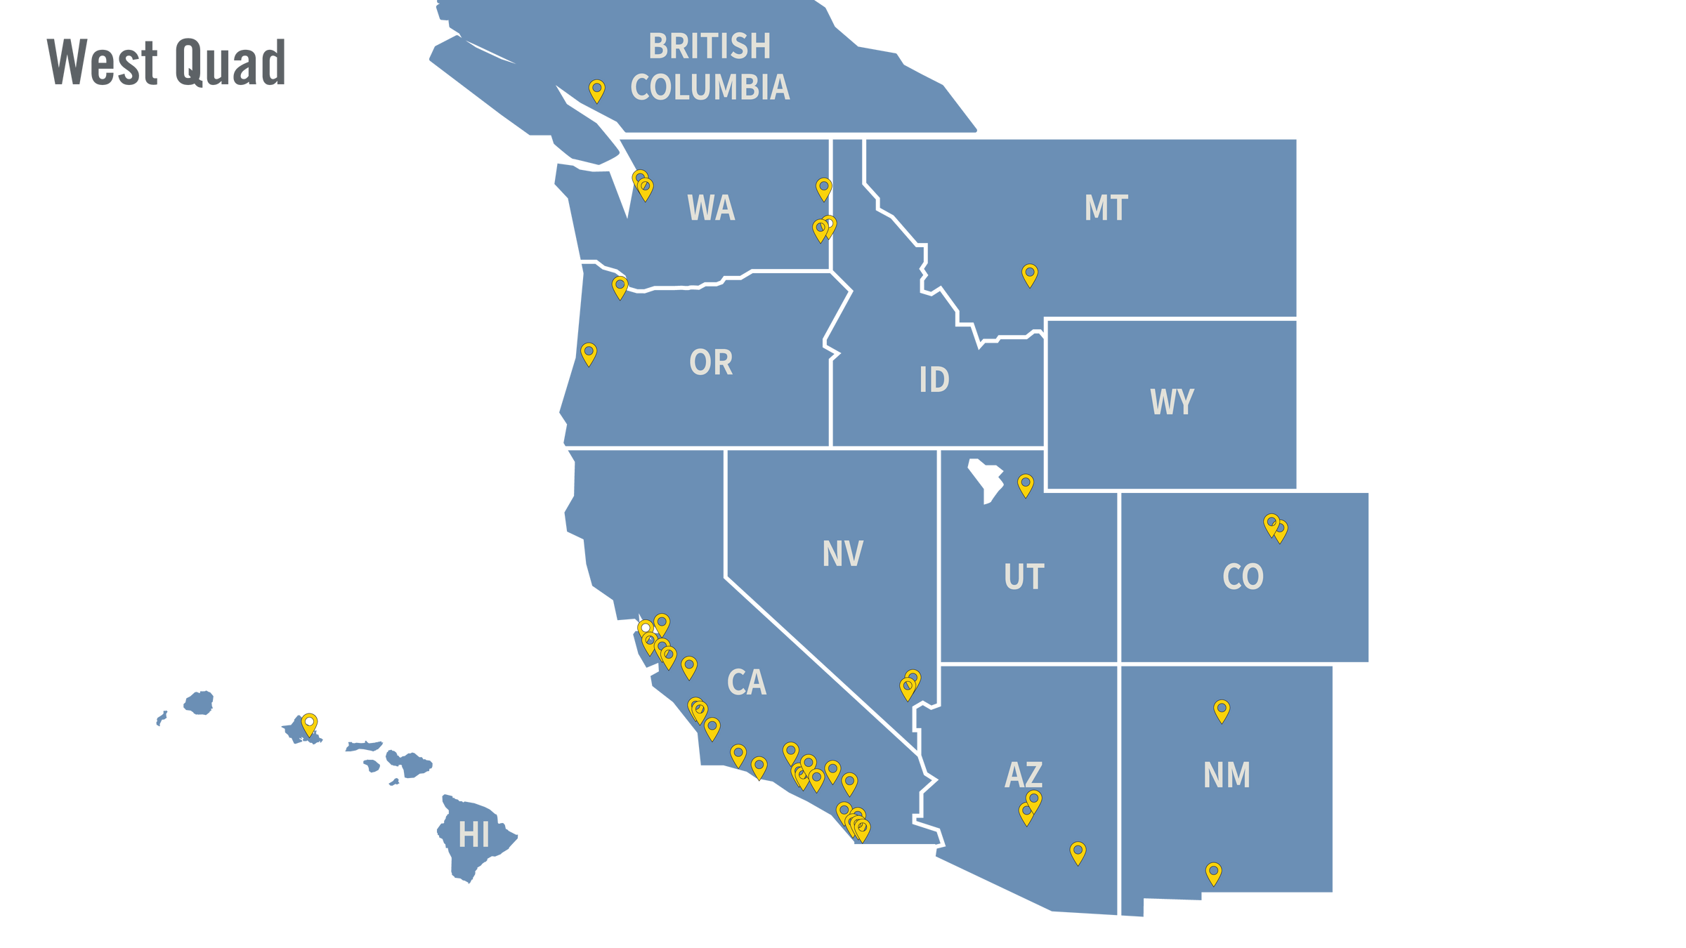
Over 62 chapters
Find your nearest AIAS Chapter here

Slide 42
West Quad Director
Tristan Osorio
University of Nevada, Las Vegas
west@aias.org
Calendly
@aiaswest
westquad.slack.com

Slide 43
What do Quad and Regional Directors Do?
Quad/Regional Directors
Main point of contact between you and the National Office
Chat with chapters and provide support and guidance
Sit on the AIAS Board of Directors
Board Liaisons to the National Committees
Accessing Quad/Regional Directors!
Monthly Calls in your Quad/Region
Quad or International Slack Channels
Connecting in Quad and National Conferences

Slide 44
THAT WAS A LOT OF INFORMATION!

Slide 45
SO TO RECAP

Slide 46
Presentation Review
1
National Communications
6
National Committees, Task Forces, and Leadership Opportunities
AIAS National Instagram & Linkedin
NEWS Section on AIAS Website
Emails and Weekly Newsletters
AIAS Chapter Emails
Committees and Task Forces
NCARB Student Licensing Advisor
AIAS Activists
AIAS Board of Directors
NAAB Accreditation Team Student Representatives
2
National Programming
7
National Conferences and Events
Crit Journal and Crit Scholar
CAMP
THRIVE Webinar
Freedom By Design
Grassroots
FORUM
Leadership Day
3
Competitions | Scholarships & Fellowships | Career Center
8
Council of Presidents
Competitions
Scholarships & Fellowships
Career Center
Voting
Delegate/Proxy
Chat with National Vice President
Chat with National President
4
AIAS Merchandise
9
Connect with the Alliance
Nationals
Quad/Regional
Graduation
ACSA
AIA
NAAB
NCARB
NOMA/S
5
Recognizing Hard Work and Accomplishments
10
Quad/Regional Level
Chapter Leader of the Month
AIAS Honor Awards
Celebrating the Graduating Class
Latin America Region
Middle East Region
Midwest Quad
Northeast Quad
South Quad
West Quad

Slide 47
QUESTIONS?
COMMENTS?
THOUGHTS?

Slide 48
CONTACT YOUR
QUAD/REGIONAL DIRECTOR
NATIONAL OFFICERS

Slide 49
National President
Cooper Moore
president@aias.org
National Vice President
Nicole Bass
vicepresident@aias.org
Latin America Regional Director
Paulina Garza Gonzalez
latinamerica@aias.org
Middle East Regional Director
Marcelle El Achkar
middleeast@aias.org
Midwest Quad Director
Ethan Sandburg
midwest@aias.org
Northeast Quad Director
Julia Andor
northeast@aias.org
South Quad Director
Colt Brock
south@aias.org
West Quad Director
Tristan Osorio
west@aias.org

